Slide 1
Final Engagement
Attack of a Vulnerable Network by Adam, Anupam, Gaurav, Jorge, Joshua, Nicholas

Slide 2
Table of Contents
This document contains the following resources:
Network Topology & Critical Vulnerabilities
Exploits Used
Methods Used to Avoiding Detect

Slide 3

Network Topology
& Critical Vulnerabilities
‹#›

Slide 4
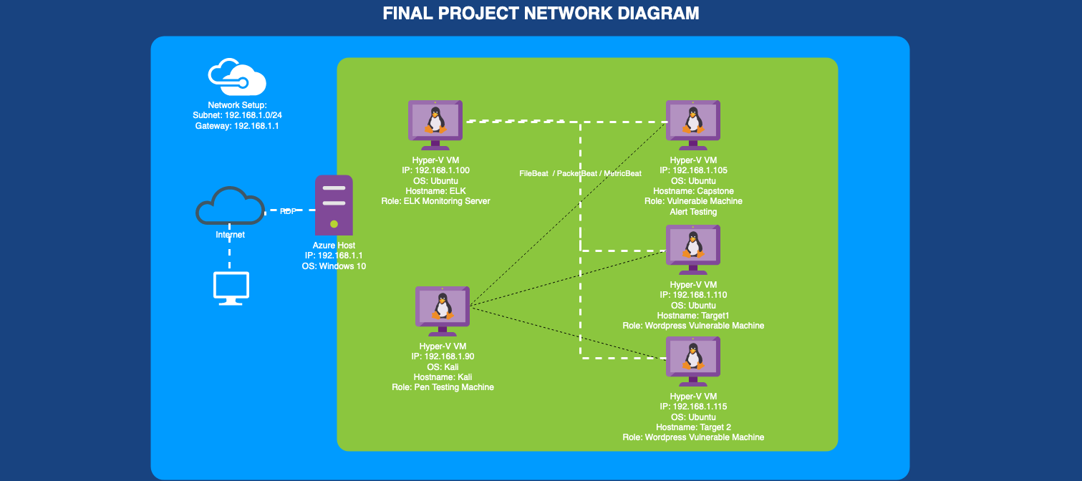
Network Topology
Network
Address Range: 192.168.1.0/24
Gateway: 192.168.1.1
Machines
IPv4: 192.168.1.90
OS: Debian Kali 5.4.0
Hostname: Kali
IPv4: 192.168.1.110
OS: Debian GNU/Linux 8
Hostname: Target 1
IPv4: 192.168.1.115
OS: Debian GNU/Linux 8
Hostname: Target 2
IPv4: 192.168.1.105
OS: Ubuntu 18.04
Hostname: Capstone
IPv4: 192.168.1.100
OS: Ubuntu 18.04
Hostname: ELK
Notes:
Jorge

Slide 5
Critical Vulnerabilities: Target 1
Our assessment uncovered the following critical vulnerabilities in Target 1.
Vulnerability | Description | Impact
Networking Mapping | The command - nmap was used to discover the open ports | The attackers will be discover the open ports and tailor their attack accordingly.
User Enumeration and Weak Passwords | Able to find password for the user ‘michael’ using dictionary brute force. | Allowing attacker to gain access to confidential files.
Improper password storage | Unsalted password hashes stored in the database. | By using John the Ripper and the password hashes, malicious actor can gain unauthorised access to user accounts.
Privilege escalation | User ‘steven’ had sudo capabilities for running the command ‘python’ which can be used for root escalation | Attacker can gain root access to the system or the network and can be used to steal data, install malware etc
Plain text password in configuration files. | Wordpress uses the wp-config.php file to store password that is used to log in to the backend MySQL database | The attackers might be able discover a file containing login information for the MySQL database.
Data Exfiltration | By browsing through the various tables in the MySQL database, the attackers will be able to discover all password hashes of all the users | The attackers are able to exfiltrate the password hashes and crack them with John the Ripper.
Notes:
Anupam

Slide 6
Exploits Used
‹#›

Slide 7
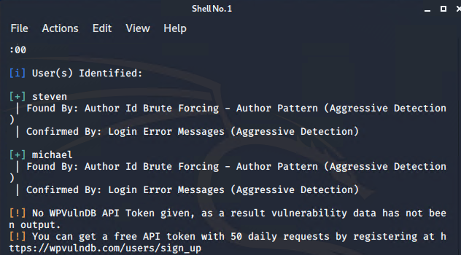
Exploitation: WordPress Enumeration
Summarize the following:
WPScan was used to determine different aspects of the wordpress installed on Target1
This help to gain information like user accounts available on wordpress. User account “michael” & “steven” was discovered.
` wpscan --url http://192.168.1.110/wordpress--enumerate u`
Notes:
Gaurav

Slide 8
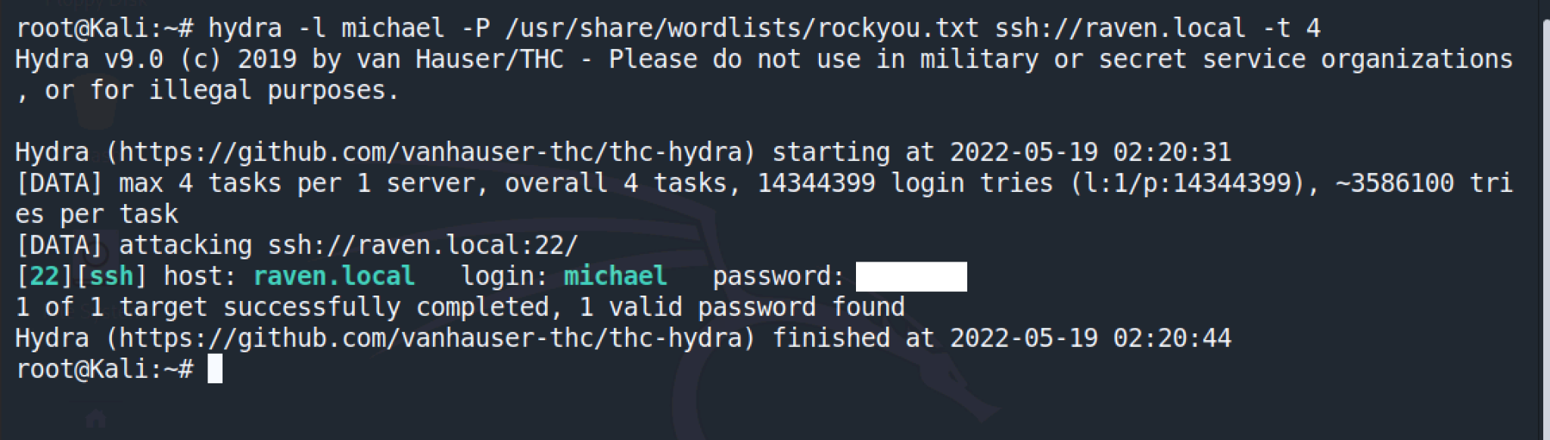
Exploitation: OPEN PORT 22 SSH/ Weak Password
Summarize the following:
Hydra was used to crack users weak password and SSH to the system
This help to gain access to user Michael account.
Include a screenshot or command output illustrating the exploit.
Notes:
Gaurav

Slide 9
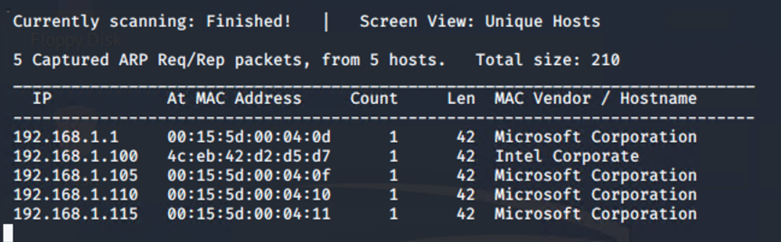
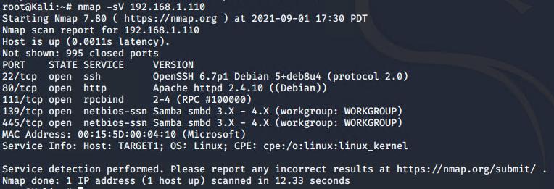
Exploitation: Network Mapping
Summarize the following:
First use netdiscover -r to identify the IP addresses of target of the network.
Then, use nmap with the syntax -sV to the targeted IP address and there are 5 ports that are open or potential points of entry.
One of the port, which is port 22 is opened and allowed the attackers to SSH.
Notes:
Joshua

Slide 10
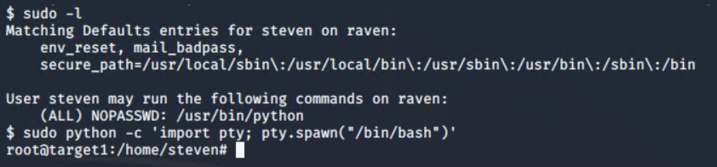
Exploitation: Privilege Escalation
Summarize the following:
How did you exploit the vulnerability?
Using `sudo -l` to gain information needed to perform escalation
Using `sudo python -c 'import pty; pty.spawn("bin/bash")`' access to escalate to root
What did the exploit achieve? Achieved root access on the machine
Notes:
Nicholas

Slide 11
Avoiding Detection
‹#›

Slide 12
Stealth Exploitation of Networking Mapping of WordPress
Monitoring Overview
Which alerts detect this exploit?
HTTP Request size monitor
Which metrics do they measure?
When sum() of http.request.bytes OVER all documents is ABOVE 3500 the the last 1 minutes.
Which thresholds do they fire at?
The alert gets triggered if it reaches 3500 bytes in a minute from the same IP source.
Notes:
Jorge

Slide 13
Stealth Exploitation of Networking Mapping of WordPress cont.
Mitigating Detection
How can you execute the same exploit without triggering the alert?
Do not scan all ports.
Use nmap scans that are known to be stealthy like SYN scan.
nmap -sS -sV
Are there alternative exploits that may perform better?
The nmap parameter “paranoid” or “sneaky” can be used in conjunction with other nmap flags. This would allow nmap to do the scans at sneaky speed (although trade off might be slow speed).
Notes:
Jorge

Slide 14
Stealth Exploitation of WordPress Enumeration
Monitoring Overview
Which alerts detect this exploit?
Excessive HTTP Errors
Which metrics do they measure?
When count() GROUPED OVER top 5 ‘http.response.status_code’ is above 400 for the last 5 minutes.
Which thresholds do they fire at?
The alert gets triggered if it grouped http response status codes above 400 every 5 minutes.
Notes:
Adam

Slide 15
Stealth Exploitation of WordPress Enumeration cont.
Mitigating Detection
How can you execute the same exploit without triggering the alert?
Do not continuously scan the wordpress site. Implement a pause on enumeration scans when possible.
Are there alternative exploits that may perform better?
The wpscan parameter “stealthy” can be used in conjunction with other scan parameters to use random user agent and passive scan.
`wpscan --url http://192.168.1.110/wordpress --enumerate u --stealthy`
Notes:
Adam

Slide 16
Stealth Exploitation of Directory Exploitation
Monitoring Overview
Which alerts detect this exploit?
CPU Usage Monitor
Which metrics do they measure?
WHEN max() OF system.process.cpu.total.pct OVER aLL documents IS ABOVE 0.5 FOR THE LAST 5 mins= measure when CPU usage is above .
The use of Metricbeat captures the usage of servers and services such as Apache
Which thresholds do they fire at?
The alerts will get triggered when the maximum CPU total percentage is over 0.5 in 5 minutes.
Notes:
Joshua

Slide 17
Stealth Exploitation of Directory Exploitation cont.
Mitigating Detection
How can you execute the same exploit without triggering the alert?
Utilizing Google dorking to find “invisible” directories and/or text documents that can provide information without setting off any alarms.
Are there alternative exploits that may perform better?
`nmap -sV -sS 192.168.1.110`
Notes:
Joshua

